Slide 1
Calendar Software Project
Robert Berghian, Henry Jones, Josh Pahman, Shelby Pham,
Illiana Rodriguez, Isaiah Shadd, Nathaniel Tan

Slide 2
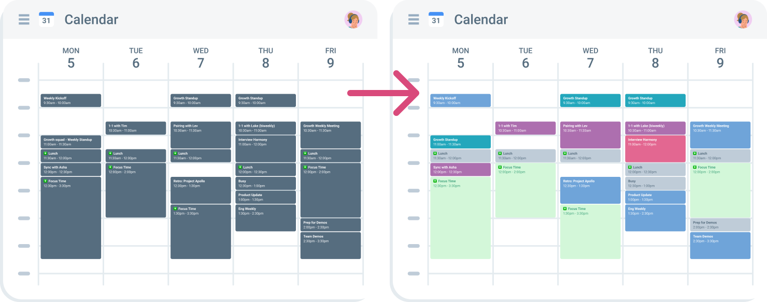
Objective
Make a versatile calendar software designed to offer a range of essential features for effective time management and organization.
Various viewing options, each displaying events and schedules
Add, edit, delete, and categorize events
Color-coding
Conflict checking
Alerts
Recurring events
Zooming and scrolling
A calendar after being organized with color, increasing readability

Slide 3
Cost Estimation
Application Composition Model, reusing 50% of objects from a GUI library
Number of screens = 4 (Calendar, Create Event, Edit Event, Share Event)
Number of sections = 9 (Email, Password, Account Identifier, Time, Date, Location, Duration, Repetitions, Description)
Number of data tables = 2 (User Information, Event Information)
Screen object points + Total report object points = 4 + 7 = 11
NOP: (11 * (100 - 50)) / 100 = 5.5
PROD: (4 + 13) / 2 = 8.5
Effort = 5.5/8.5 ≅ 0.64706 person-month

Slide 4
Cost Estimation
Storage Costs:
Event Database: 80Gb event file for 1 million users: $18.40 / month
User Database: .02Gb file for 1 million users: $0.0005175 / month
API calls:
Worst case: 6 million HTTP, 6 million REST, 6 million Websocket / day: $1003.75 / month
Normal Load: 3 million HTTPs, 2 million REST, 1 million Websocket / day: $334 / month
Optimized Calls: 1.5 million HTTP, 1 million REST, .5 million Websocket / day: $167 / month
$5000 5 developer systems

Slide 5
Salary Estimation
$30,000 for 5 junior developers during initial 3 week development.
$13,500 / month for 2 developers to maintain service / develop new features.
$7,500 / month for a project manager throughout.

Slide 6
Project Timeline
Week 1 - Project Design and Prototype
Week 2 - Final Program
Week 3 - Testing and Debugging

Slide 7
Functional/Non-Functional Requirements
Functional
Event Scheduling
Includes conflict detection
Multiple Calendar Views
Monthly, Weekly, Daily
Agenda (shows all events as a list)
Alerts/Notifications
Search for events
Sharing events between app users
Data Import/Export to similar calendar softwares
Non-Functional
Intuitive, user-friendly UI
Maximum response time of 2 seconds for user interactions, 3 seconds for loading views
Support up to 500 users
99.9% uptime
Optimize data storage and security
Prioritize user authentication and authorization
Protect against cross-site scripting (XSS) and SQL injection

Slide 8
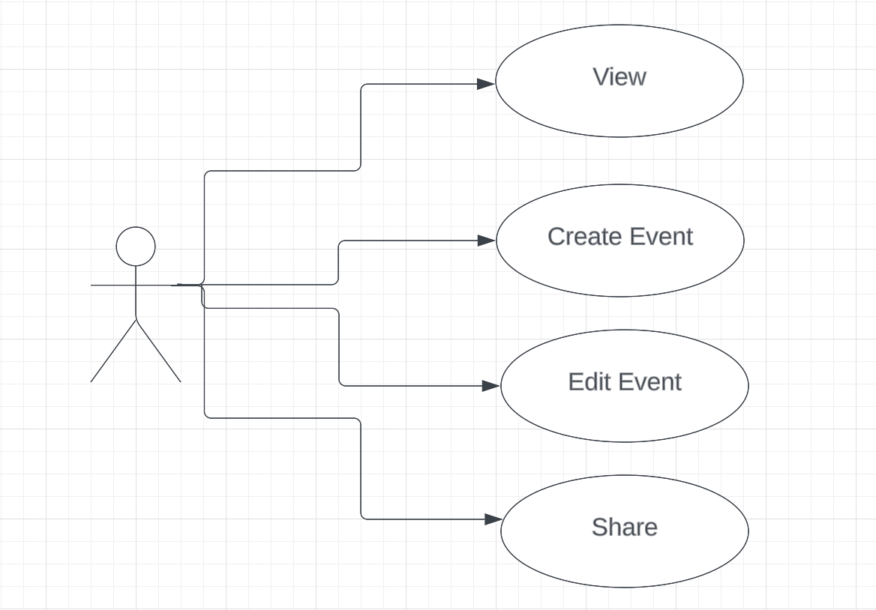
Use Case Diagram
View
User views calendar in a variety of ways (monthly, weekly, daily, agenda)
Create event
User creates an event that will be added to the calendar
Edit event
User edits an event that will be updated in the calendar
Share
User shares event to another user of the software

Slide 9
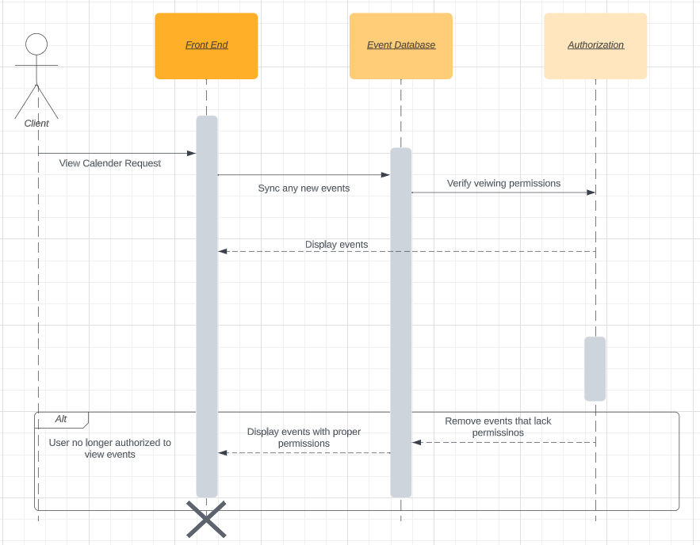
Sequence Diagram
View
Client makes request to view calendar via UI
New events are synced
Database sends request to verify viewing permissions
If permission is verified, calendar is displayed to user
Otherwise, user is unauthorized to view events

Slide 10
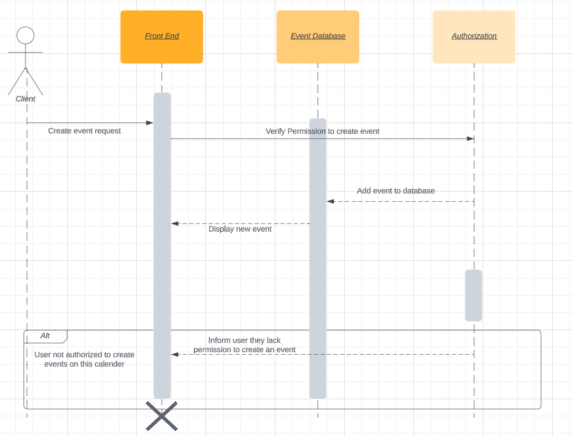
Sequence Diagram
Create Event
User submits a create event request
Permission is verified
If permission is verified:
Event is added to database
New event is displayed to user
Otherwise:
Displays status message informing user of authorization failure

Slide 11
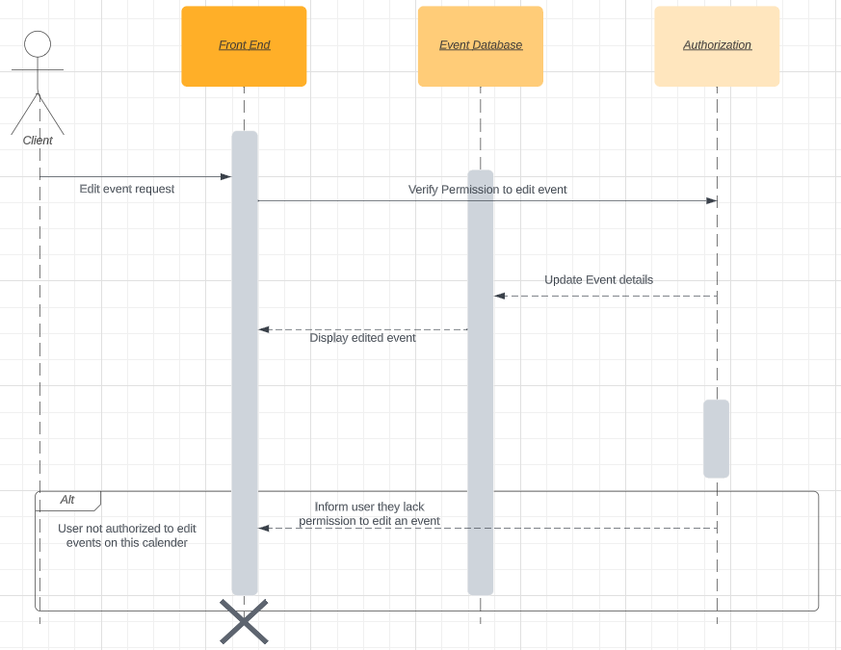
Sequence Diagram
Edit Event
User submits an edit event request
Permission is verified
If permission is verified:
Event is updated in database
Updated event is displayed to user
Otherwise:
Displays status message informing user of authorization failure

Slide 12
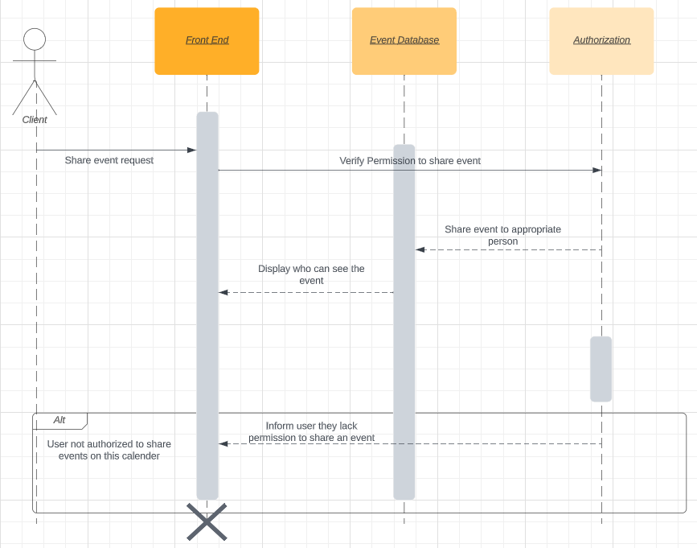
Sequence Diagram
Share
User submits a share event request
Permission is verified
If permission is verified:
Event is shared to appropriate user
List of users who can see event displayed
Otherwise:
Displays status message informing user of authorization failure

Slide 13
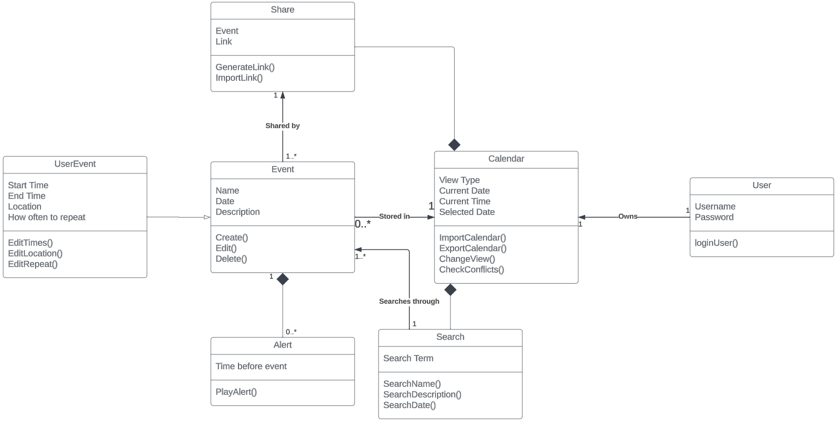
Class Diagram

Slide 14
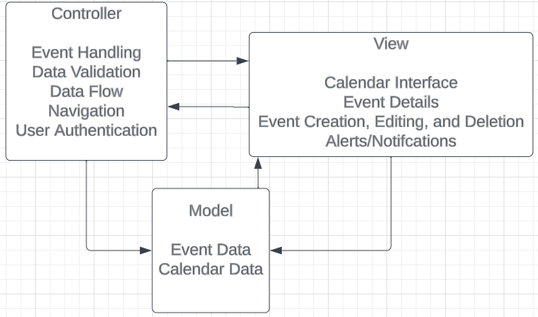
Architectural Design
Model-View-Controller (MVC) Pattern
Model
Event Data: Title, Date, Time, Location, Event-Specific Information
Calendar Data: Date Ranges, Holidays, Other Special Days
View
Calendar Interface: Grid, Navigation Controls, Event Details
Event Details
Event Creation, Editing, and Deletion
Alerts/Notifications
Controller
Event Handling: User Activities such as clicking on dates or events
Data Validation: Ensure that user inputs are valid to maintain data integrity
Data Flow: Manage data flow between Model and View components
Navigation
User Authentication

Slide 15
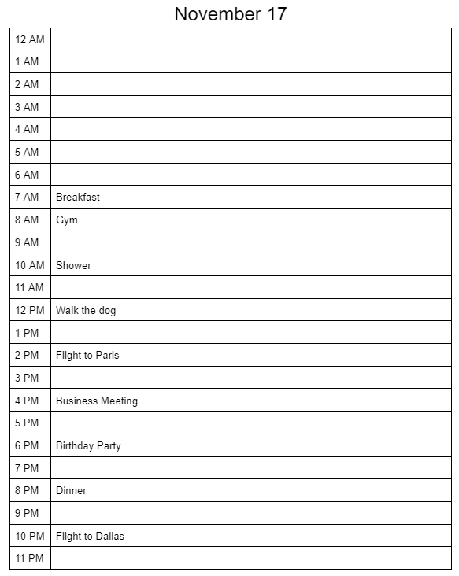
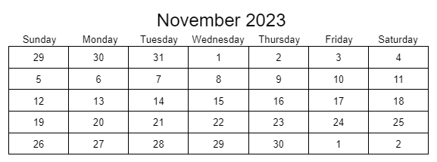

UI Demo
Daily View
Monthly View
Weekly View

